Slide 1
C
Pointers

Slide 2
C Header Files
<assert.h> Program assertion functions
<ctype.h> Character type functions
<locale.h> Localization functions
<math.h> Mathematics functions
<setjmp.h> Jump functions
<signal.h> Signal handling functions
<stdarg.h> Variable arguments handling functions
<stdio.h> Standard Input/Output functions
<stdlib.h> Standard Utility functions
<string.h> String handling functions
<time.h> Date time functions
Address in C
scanf("%d", &var);

Slide 3
C Header Files
<assert.h> Program assertion functions
<ctype.h> Character type functions
<locale.h> Localization functions
<math.h> Mathematics functions
<setjmp.h> Jump functions
<signal.h> Signal handling functions
<stdarg.h> Variable arguments handling functions
<stdio.h> Standard Input/Output functions
<stdlib.h> Standard Utility functions
<string.h> String handling functions
<time.h> Date time functions
Example
Example 5.1
Address in C

Slide 4
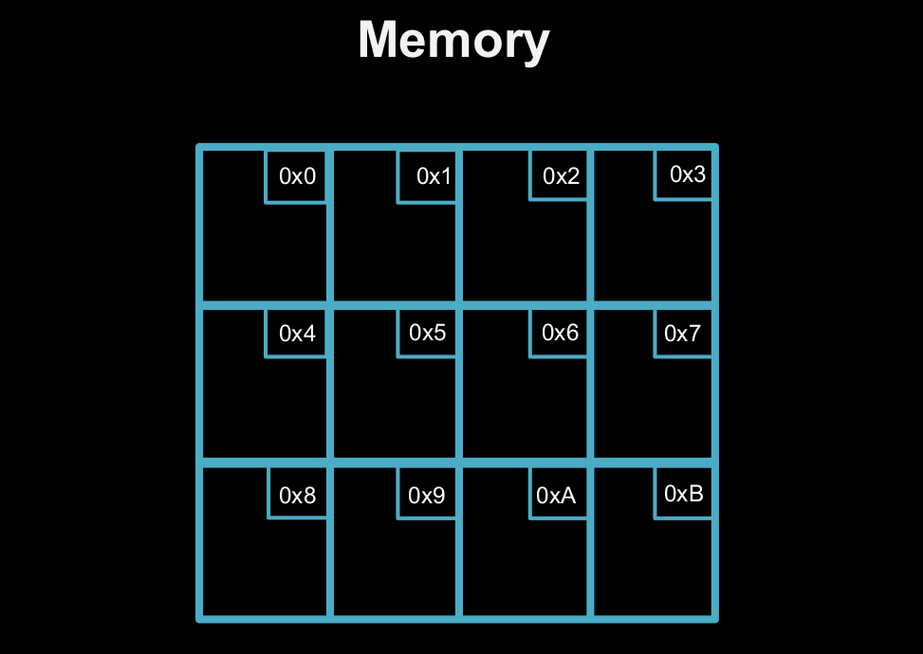
C Header Files
<assert.h> Program assertion functions
<ctype.h> Character type functions
<locale.h> Localization functions
<math.h> Mathematics functions
<setjmp.h> Jump functions
<signal.h> Signal handling functions
<stdarg.h> Variable arguments handling functions
<stdio.h> Standard Input/Output functions
<stdlib.h> Standard Utility functions
<string.h> String handling functions
<time.h> Date time functions
Formatting
arrayname [position number]
First element at position 0
arr [0] = 3;
arr [ 5 – 2 ] == arr [ 3 ] == arr [ x ]
What is an array?

Slide 5
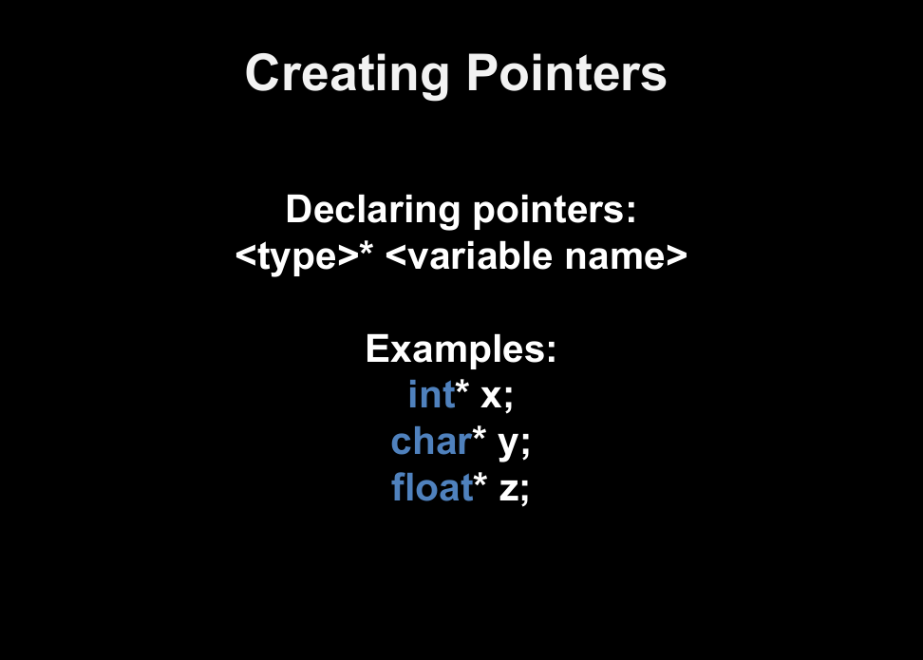
C Header Files
<assert.h> Program assertion functions
<ctype.h> Character type functions
<locale.h> Localization functions
<math.h> Mathematics functions
<setjmp.h> Jump functions
<signal.h> Signal handling functions
<stdarg.h> Variable arguments handling functions
<stdio.h> Standard Input/Output functions
<stdlib.h> Standard Utility functions
<string.h> String handling functions
<time.h> Date time functions
Formatting
arrayname [position number]
First element at position 0
arr [0] = 3;
arr [ 5 – 2 ] == arr [ 3 ] == arr [ x ]
What is an array?

Slide 6
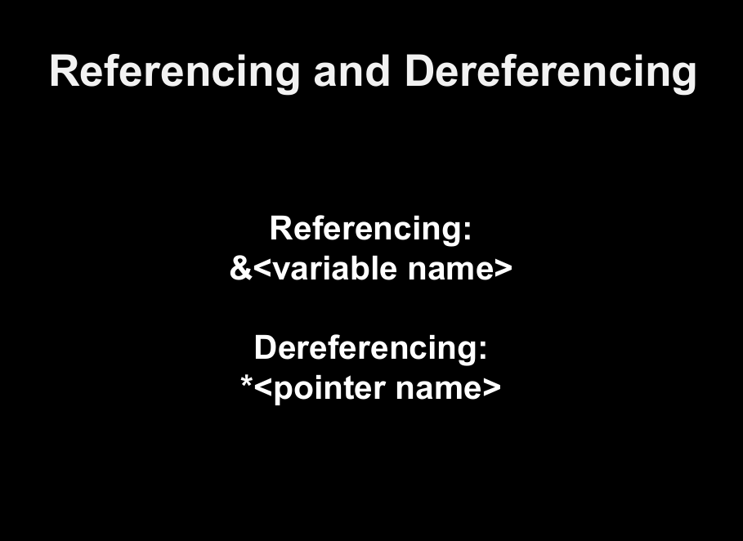
C Header Files
<assert.h> Program assertion functions
<ctype.h> Character type functions
<locale.h> Localization functions
<math.h> Mathematics functions
<setjmp.h> Jump functions
<signal.h> Signal handling functions
<stdarg.h> Variable arguments handling functions
<stdio.h> Standard Input/Output functions
<stdlib.h> Standard Utility functions
<string.h> String handling functions
<time.h> Date time functions
Formatting
arrayname [position number]
First element at position 0
arr [0] = 3;
arr [ 5 – 2 ] == arr [ 3 ] == arr [ x ]
What is an array?

Slide 7
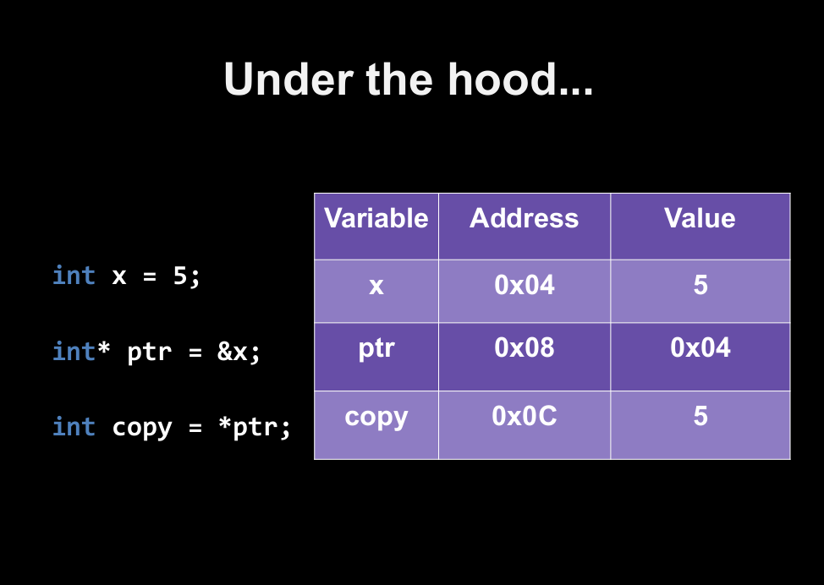
C Header Files
<assert.h> Program assertion functions
<ctype.h> Character type functions
<locale.h> Localization functions
<math.h> Mathematics functions
<setjmp.h> Jump functions
<signal.h> Signal handling functions
<stdarg.h> Variable arguments handling functions
<stdio.h> Standard Input/Output functions
<stdlib.h> Standard Utility functions
<string.h> String handling functions
<time.h> Date time functions
Formatting
arrayname [position number]
First element at position 0
arr [0] = 3;
arr [ 5 – 2 ] == arr [ 3 ] == arr [ x ]
What is an array?

Slide 8
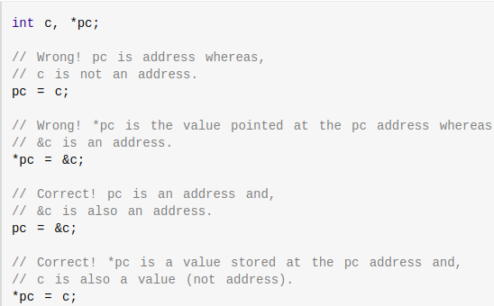
C Header Files
<assert.h> Program assertion functions
<ctype.h> Character type functions
<locale.h> Localization functions
<math.h> Mathematics functions
<setjmp.h> Jump functions
<signal.h> Signal handling functions
<stdarg.h> Variable arguments handling functions
<stdio.h> Standard Input/Output functions
<stdlib.h> Standard Utility functions
<string.h> String handling functions
<time.h> Date time functions
Common Mistakes
In pointers!

Slide 9
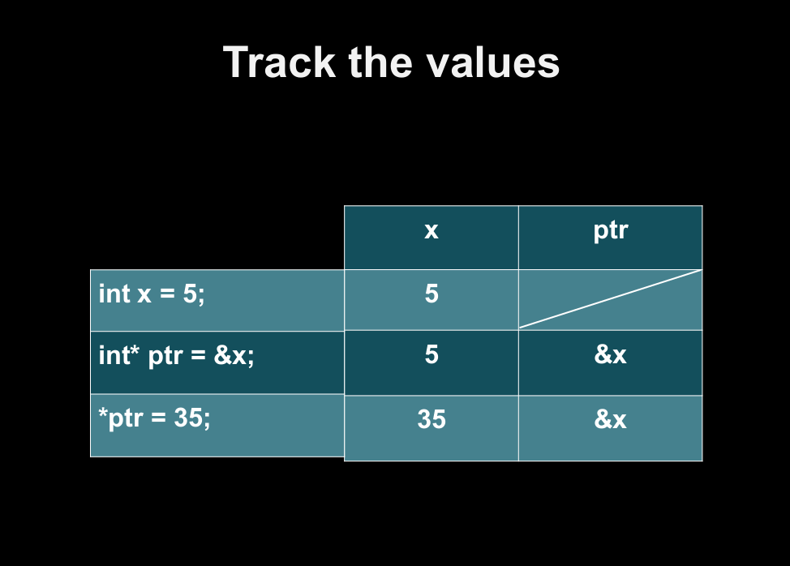
C Header Files
<assert.h> Program assertion functions
<ctype.h> Character type functions
<locale.h> Localization functions
<math.h> Mathematics functions
<setjmp.h> Jump functions
<signal.h> Signal handling functions
<stdarg.h> Variable arguments handling functions
<stdio.h> Standard Input/Output functions
<stdlib.h> Standard Utility functions
<string.h> String handling functions
<time.h> Date time functions
Formatting
arrayname [position number]
First element at position 0
arr [0] = 3;
arr [ 5 – 2 ] == arr [ 3 ] == arr [ x ]
What is an array?

Slide 10
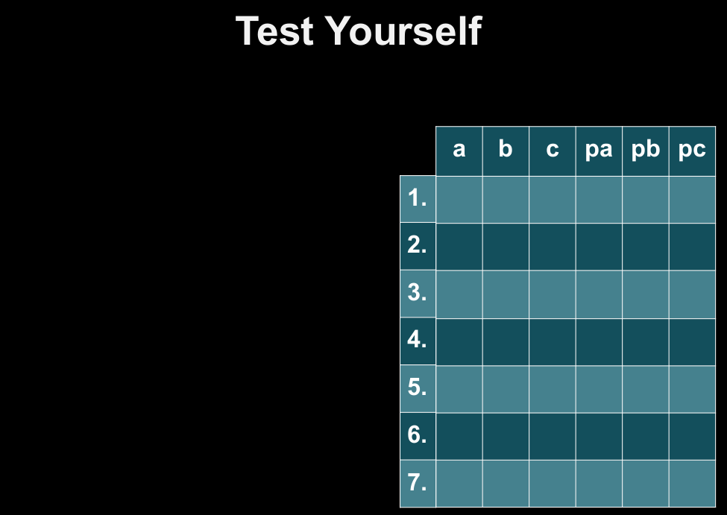
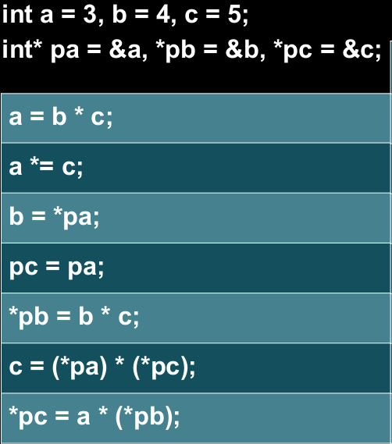
C Header Files
<assert.h> Program assertion functions
<ctype.h> Character type functions
<locale.h> Localization functions
<math.h> Mathematics functions
<setjmp.h> Jump functions
<signal.h> Signal handling functions
<stdarg.h> Variable arguments handling functions
<stdio.h> Standard Input/Output functions
<stdlib.h> Standard Utility functions
<string.h> String handling functions
<time.h> Date time functions
Formatting
arrayname [position number]
First element at position 0
arr [0] = 3;
arr [ 5 – 2 ] == arr [ 3 ] == arr [ x ]
What is an array?

Slide 11
C Header Files
<assert.h> Program assertion functions
<ctype.h> Character type functions
<locale.h> Localization functions
<math.h> Mathematics functions
<setjmp.h> Jump functions
<signal.h> Signal handling functions
<stdarg.h> Variable arguments handling functions
<stdio.h> Standard Input/Output functions
<stdlib.h> Standard Utility functions
<string.h> String handling functions
<time.h> Date time functions
C Call by Reference
Example 5.2
In pointers!

Slide 12
Questions?

Slide 13
C
Strings

Slide 14
C Header Files
<assert.h> Program assertion functions
<ctype.h> Character type functions
<locale.h> Localization functions
<math.h> Mathematics functions
<setjmp.h> Jump functions
<signal.h> Signal handling functions
<stdarg.h> Variable arguments handling functions
<stdio.h> Standard Input/Output functions
<stdlib.h> Standard Utility functions
<string.h> String handling functions
<time.h> Date time functions
String Declaration
char address[]={'T', 'E', 'X', 'A', 'S', '\0'};
char address[]="TEXAS";
//In the above declaration NULL character (\0) will automatically be inserted at the end of the string.

Slide 15
C Header Files
<assert.h> Program assertion functions
<ctype.h> Character type functions
<locale.h> Localization functions
<math.h> Mathematics functions
<setjmp.h> Jump functions
<signal.h> Signal handling functions
<stdarg.h> Variable arguments handling functions
<stdio.h> Standard Input/Output functions
<stdlib.h> Standard Utility functions
<string.h> String handling functions
<time.h> Date time functions
Read & write Strings
Example 5.3
using Printf() and Scanf()

Slide 16
C Header Files
<assert.h> Program assertion functions
<ctype.h> Character type functions
<locale.h> Localization functions
<math.h> Mathematics functions
<setjmp.h> Jump functions
<signal.h> Signal handling functions
<stdarg.h> Variable arguments handling functions
<stdio.h> Standard Input/Output functions
<stdlib.h> Standard Utility functions
<string.h> String handling functions
<time.h> Date time functions
Read & write Strings
Example 5.4
using gets() and puts()

Slide 17
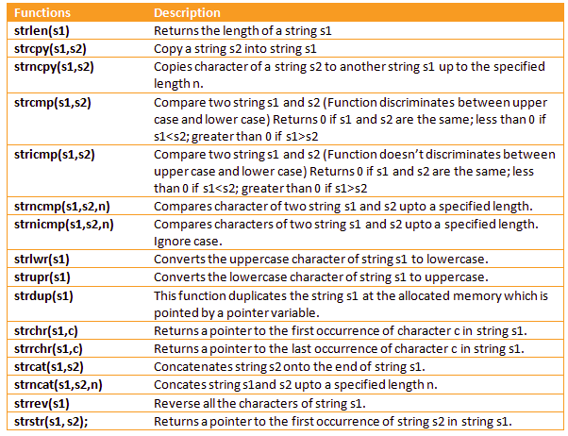

Slide 18
Example 5.4 - 5.8

Slide 19


Slide 20
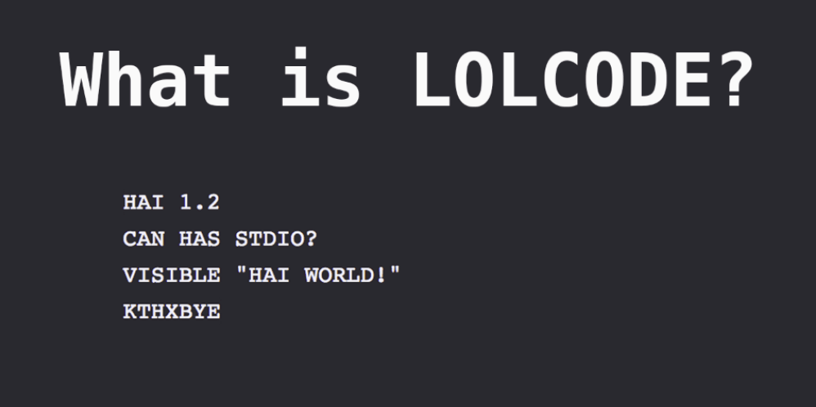
C
Strings

